Slide 1




How do researchers fabricate data and how to detect fabrication?
Chris Hartgerink
@chartgerink
www.chjh.nl
May 29, 2016
Notes:
Hi everyone,
In recent years we have seen some cases of data fabrication in psychology and statistics have played a role in confirming initial suspicions.
As Richard Morey pointed out this morning, these tools have sometimes been developed and tested on the same data.
Regardless, using statistics as a screening tool for potential data fabrication is interesting, but we need to now the validity of these ad hoc developed methods

Slide 2
“I had a student who fabricated the results of his MA study, but he simply copy-pasted subjects”
“this did not require a genius to find out.”
-Anonymous
Notes:
I received an email recently saying that one of their students fabricated data by copy-pasting.

Slide 3
“I had a student who fabricated the results of his MA study, but he simply copy-pasted subjects”
“this did not require a genius to find out.”
-Anonymous
Notes:
And that it was quite easy to detect.

Slide 4
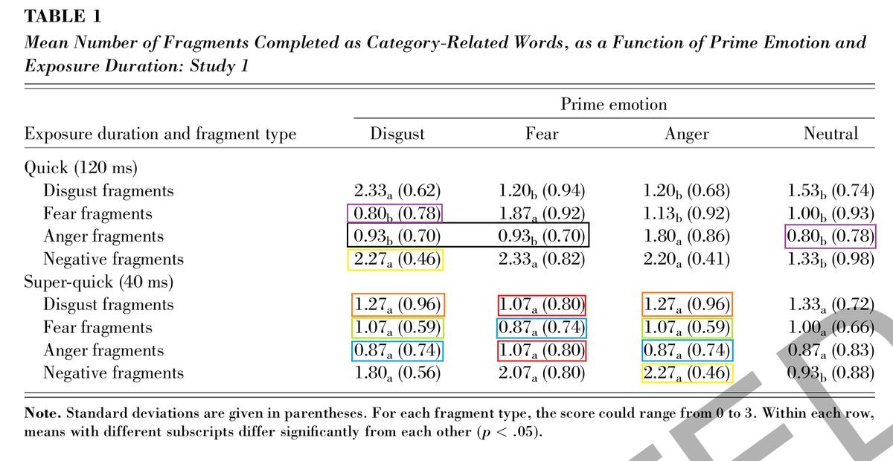
Notes:
And not only students fabricate data.
This table is from a retracted paper, where the fabricator introduced duplicates for 15 out of 32 cells (!).
This also does not require a genius to find out. And yet, it was published in 2008, and retracted only in 2012.
Does this mean that we can detect data fabrication easily though, even if it might not be this obvious?

Slide 5
Conclusions
Applied statistical tools to 36 genuine datasets, 36 fabricated datasets
How do they perform in detecting fabrication?
PPV = 91%, NPV = 59%, detected 10/36
Notes:
So we went and tested the performance of statistical tools to detect data fabrication.
1. We gathered 36 genuine and 36 fabricated datasets
2. Subjected both to two statistical tools that detect data fabrication
3. Found that the positive predictive value of the best method is fantastic, 90%!
4. The negative predictive value is reasonable at 59%
5. And that we could detect 10/36 fabricated datasets.
So, these methods underdetect data fabrication at large, but when it detects it seems to do so for valid reasons.

Slide 6
How can we detect data fabrication?*
*in summary results
Notes:
But let's retrace the steps we took to actually get to these conclusions, so you can assess for yourself whether you can believe in these methods.

Slide 7
How can we detect data fabrication?*
*today: summary results
Notes:
Today, I only focus on summary results such as means, standard deviations, and statistical test results.
We applied two methods to these results.

Slide 8
1. Variance of variance analysis
Notes:
First, we analyzed the variances from independent conditions.
Just like how the mean fluctuates due to sampling, variances should do so as well.

Slide 9
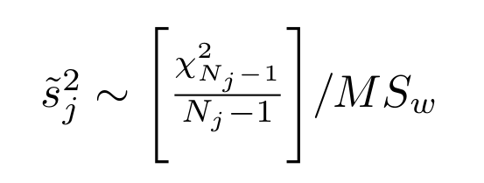
1. Variance of variance analysis
Notes:
And considering we know that the distribution of a single variance is approximated by a chi-square distribution, we can also approximate how the variance OF the variances should be distributed.

Slide 10
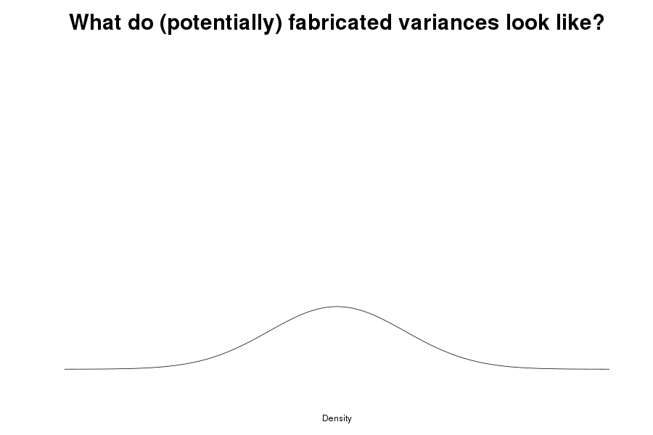
Notes:
So imagine this is how we expect the variance of the variances to look like.

Slide 11
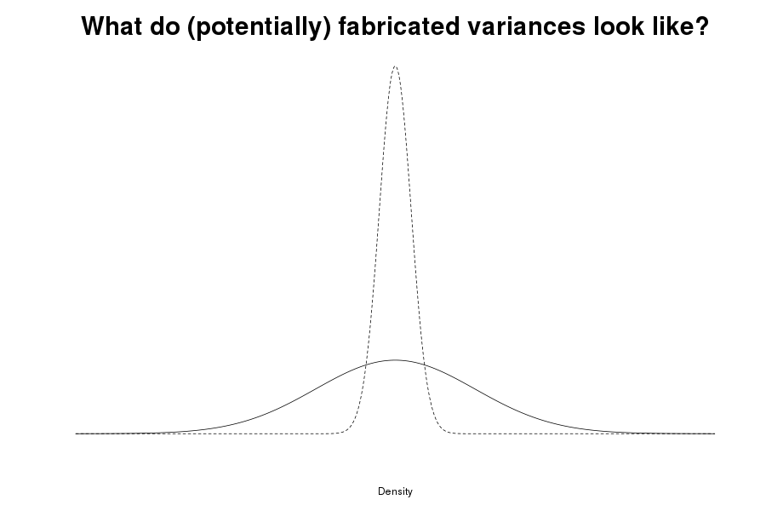
Notes:
If we then observe that the variance of variances observed in a paper look like this

Slide 12
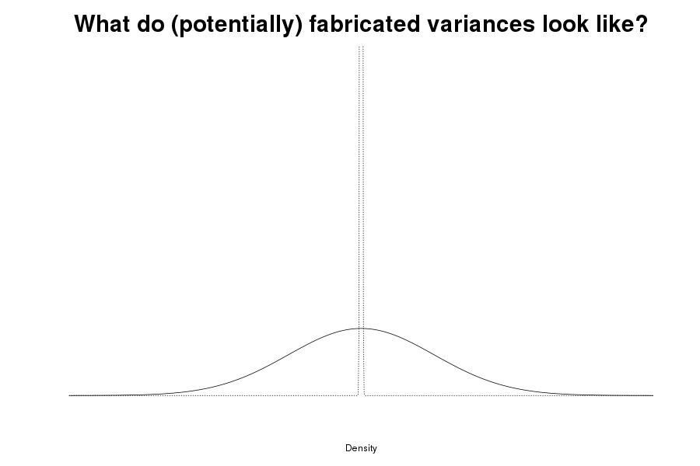
Notes:
Or even like this, then we have reason to think that these data are potentially anomalous, for example due to data fabrication just due to the immense deviation from what would be theoretically expected given sampling processes.

Slide 13
2. Nonsignificant p-values
Notes:
In the second method, we apply another theoretical boundary condition to analyze nonsignificant p-values.

Slide 14
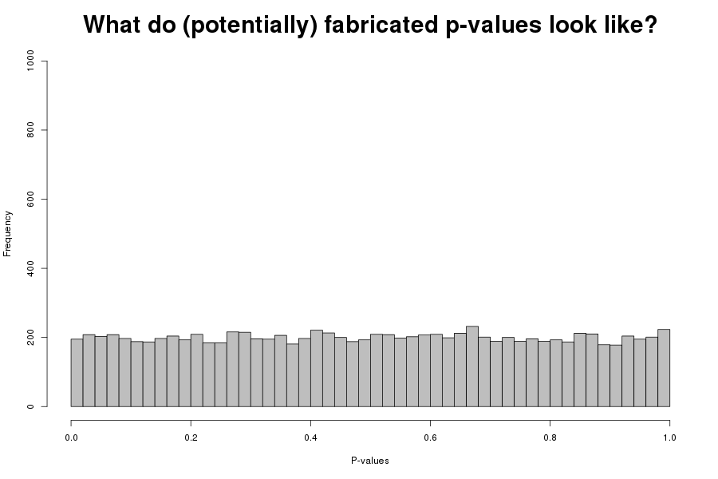
Notes:
If there is truly no effect, p-values should be uniform distributed, as shown.

Slide 15
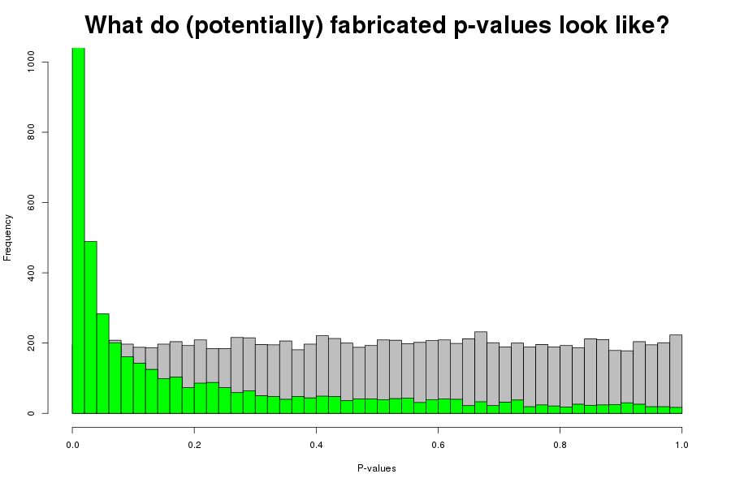
Notes:
If there truly IS an effect, p-values should be right skew distributed, as shown in the green histogram.

Slide 16
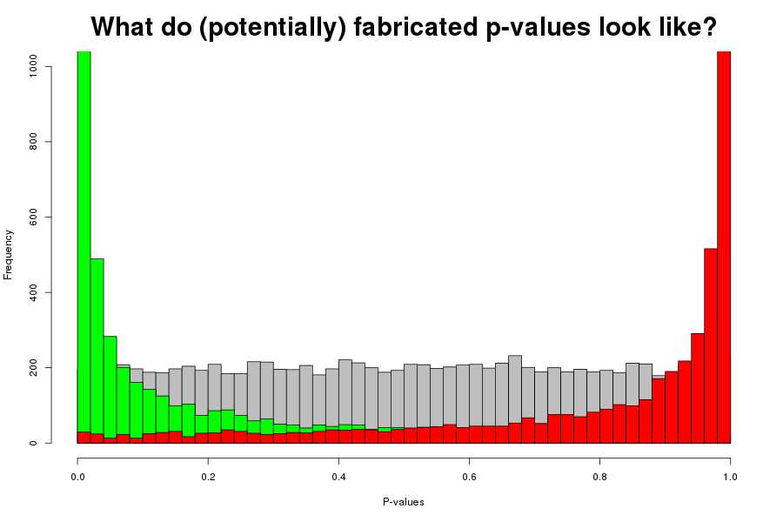
Notes:
So the red histogram should be technically impossible, except for a lot of misspecified one-tailed hypothesis tests.
We can use this information to identify nonsignificant p-values that are potentially anomalous

Slide 17
3. Simple meta-analysis of 1 + 2*
*Fisher method
Notes:
And of course, these two methods are highly specific, but we combine the evidential value for anomalous data by simply meta-analyzing the results

Slide 18
3. Simple meta-analysis of 1 + 2*
*Fisher method
Notes:
With the Fisher method.

Slide 19
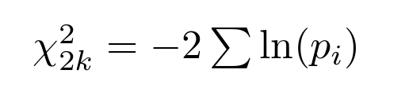
3. Simple meta-analysis of 1 + 2
Notes:
Which is a simple chi-square test of the p-values, and was actually one of the first meta-analysis methods, dating back to 1925.

Slide 20
Test this on genuine and fabricated data
Notes:
We took these methods and tested them on known genuine data, and known fabricated data. And you might ask, how did you get known fabricated data?

Slide 21
Notes:
We actually collected them ourselves!

Slide 22
 | Genuine data (Many Labs 1)
Notes:
For the genuine data, we got the Many Labs data and used the anchoring experiments.

Slide 23
 | Genuine data (Many Labs 1)
 | 36
Notes:
There were 36 labs that participated there, so we have 36 independent datasets of genuine data.

Slide 24
 | Genuine data (Many Labs 1) | Fabricated data (asked psychology researchers)
 | 36
Notes:
For fabricated data, we asked psychology researchers to fabricate data for these same experiments, with a set of hypotheses.

Slide 25
 | Genuine data (Many Labs 1) | Fabricated data (asked psychology researchers)
 | 36 | 36
Notes:
And we quotum sampled until we had 36 fabricated datasets.

Slide 26
 | Genuine data (Many Labs 1) | Fabricated data (asked psychology researchers)
“Genuine”
“Fabricated”
 | 36 | 36
Notes:
And then we tried to classify these datasets as genuine or fabricated, as depicted in the rows.
So, the columns indicate the true situation, and the rows the classification based on the test.

Slide 27
 | Genuine data (Many Labs 1) | Fabricated data (asked psychology researchers)
“Genuine”
“Fabricated”
 | 36 | 36 34
Notes:
We actually had to drop 2 fabricated datasets because they did not fabricate data in support of the hypotheses we requested them to.

Slide 28
For the best performing method
*Fisher method, at α = .05
Notes:
I will show you the results for the best performing method, which is the meta-analysis. All results I present now, are for an alpha of .05

Slide 29
 | Genuine data (Many Labs 1) | Fabricated data (asked psychology researchers)
“Genuine”
“Fabricated” | 1
 | 36 | 34
Notes:
And with this method, we had one false positive.

Slide 30
 | Genuine data (Many Labs 1) | Fabricated data (asked psychology researchers)
“Genuine”
“Fabricated” | 1 | 10
 | 36 | 34
Notes:
But 10 true positives

Slide 31
 | Genuine data (Many Labs 1) | Fabricated data (asked psychology researchers)
“Genuine”
“Fabricated” | 1 | 10 | 11
 | 36 | 34

Slide 32
 | Genuine data (Many Labs 1) | Fabricated data (asked psychology researchers)
“Genuine” | 35
“Fabricated” | 1 | 10 | 11
 | 36 | 34
Notes:
We had 35 true negatives,

Slide 33
 | Genuine data (Many Labs 1) | Fabricated data (asked psychology researchers)
“Genuine” | 35 | 24
“Fabricated” | 1 | 10 | 11
 | 36 | 34
Notes:
And 24 false negatives.

Slide 34
 | Genuine data (Many Labs 1) | Fabricated data (asked psychology researchers)
“Genuine” | 35 | 24 | 59
“Fabricated” | 1 | 10 | 11
 | 36 | 34
Notes:
So if we see these results, these methods do not fare too bad :-)

Slide 35
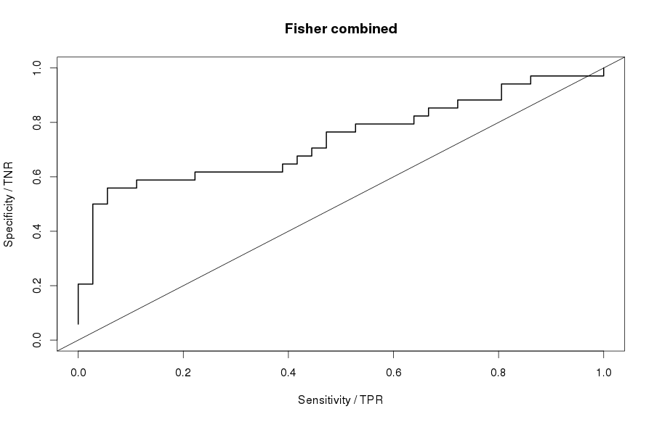
Notes:
Depicted in another way, in an ROC-curve, we also see that the combined methods provide good classification of genuine and fabricated data.

Slide 36
PPV = 91%
Notes:
The PPV, the probability of a positive result being indeed fabricated, is 91%

Slide 37
NPV = 59%
Notes:
The negative predictive value, the probability that a nonsignificant result is truly genuine, is 59%.

Slide 38
Conclusions
Applied statistical tools to 36 genuine datasets, 36 fabricated datasets
How do they perform in detecting fabrication?
PPV = 91%, NPV = 59%, detected 10/36
Slides at osf.io/ucfpv
Data, materials etc. osf.io/b24pq
Notes:
Here is just a short recap.
We tested 36 genuine and 36 fabricated datasets for data fabrication.
Statistical tools detect 10/36 fabricated data sets, with 91% true positives and 59% true negative.
As such, the statistical methods developed as ad hoc tools, seem to valid for screening purposes as well.
Feel free to reuse all data and materials, which are freely available at the OSF

Slide 39
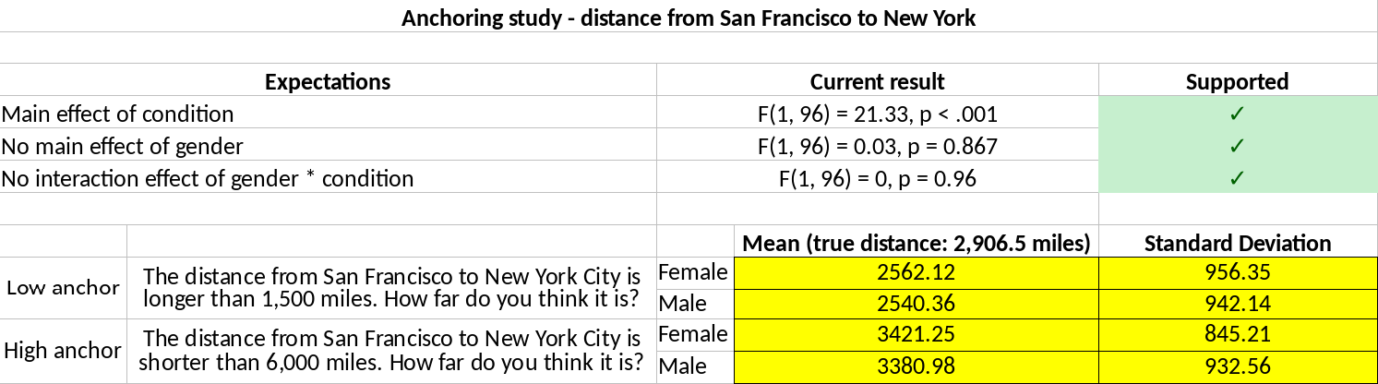
Notes:
Example of how participant fabricated results for one (out of 4) studies

Slide 40
Condition 1, females
Condition 1, males
}
σ
Condition 2, females
Condition 2, males
Notes:
The original variance of variances method assumed the same population variance for all conditions. The results of this method alone are

Slide 41
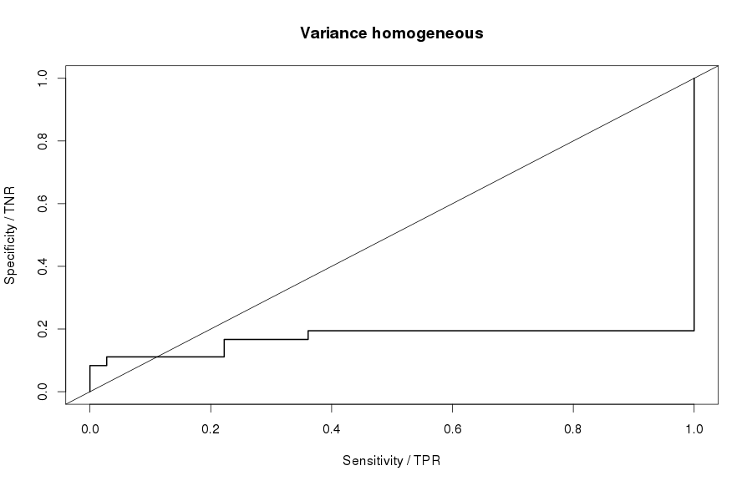
Notes:
Rather bad.

Slide 42
Condition 1, females
Condition 1, males
}
σ₁
Condition 2, females
Condition 2, males
}
σ₂
Notes:
If we adjust this method to take into account different population variances for the different conditions

Slide 43
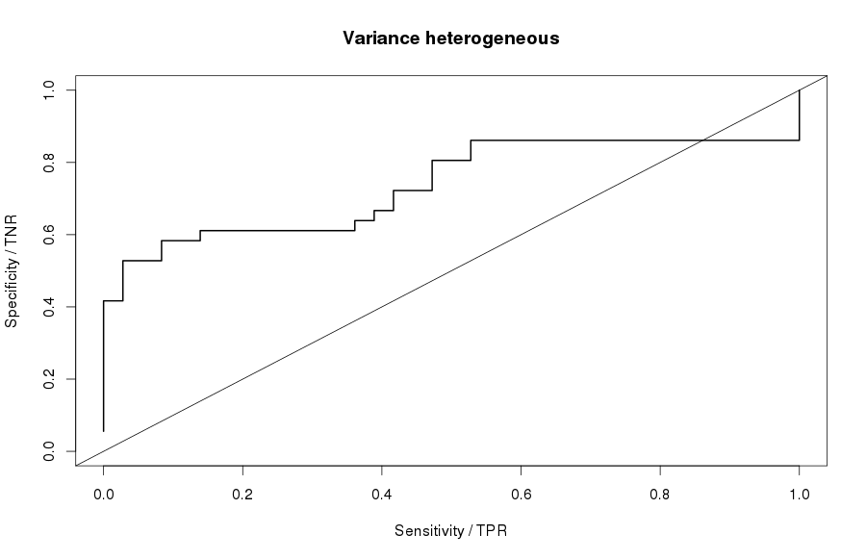
Notes:
Performance increases tremendously. So when we use the variance of variances method, we should not just blatantly assume equal population variances across conditions, because if we do the method will perform horribly.

